Slide 1
SensorEffector
Project
By Juan Rodriguez

Slide 2
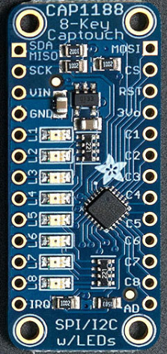
Touch Sensor
CAP1188 Breakout 8-Key Capacitive touch sensor
5 different addresses (0x28, 0x29, 0x2A, 0x2B, 0x2C)
If pins from L1 - L8 come into contact, corresponding lights aluminate
To change Address to 0x2A, connect 600k resistor to pin AD, then to ground on Pi
Purchased From https://www.adafruit.com/product/1602

Slide 3
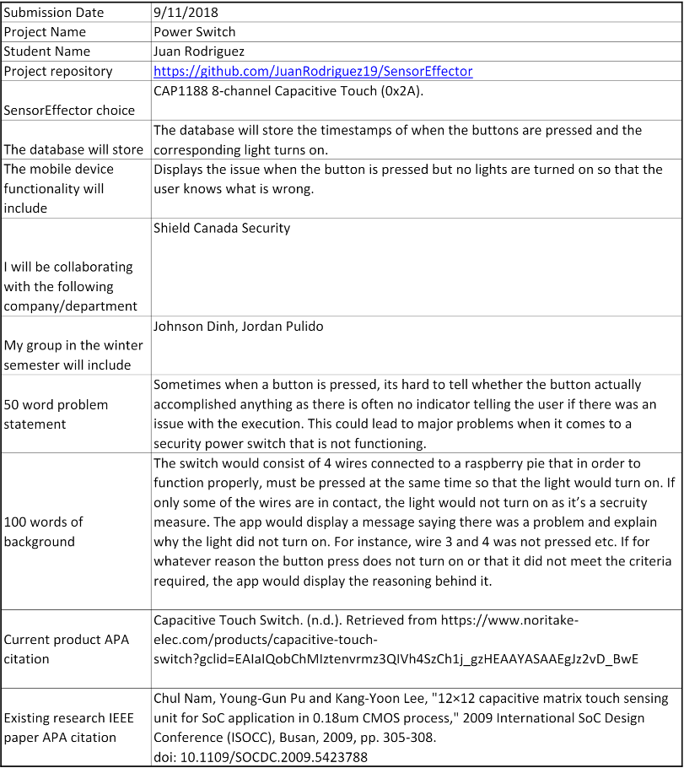
Proposal

Slide 4
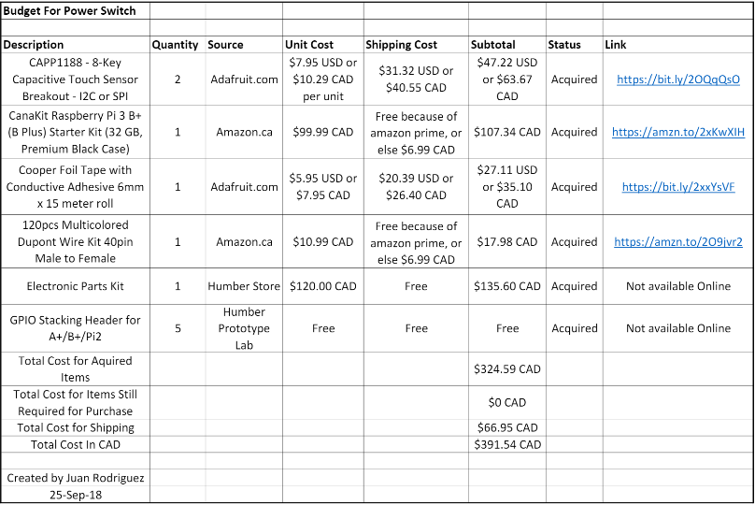
Budget

Slide 5
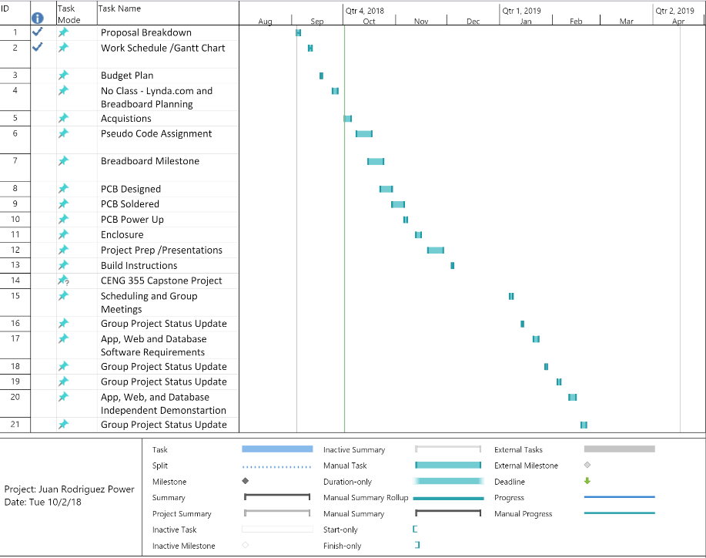
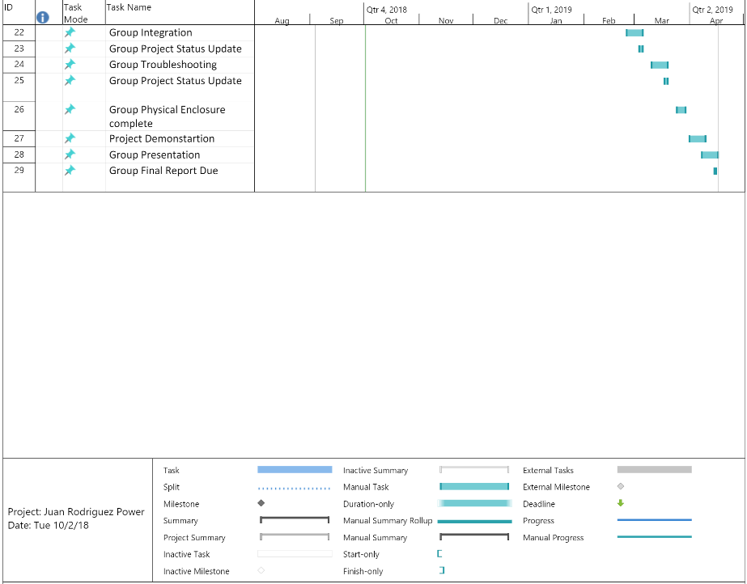
Work Schedule

Slide 6
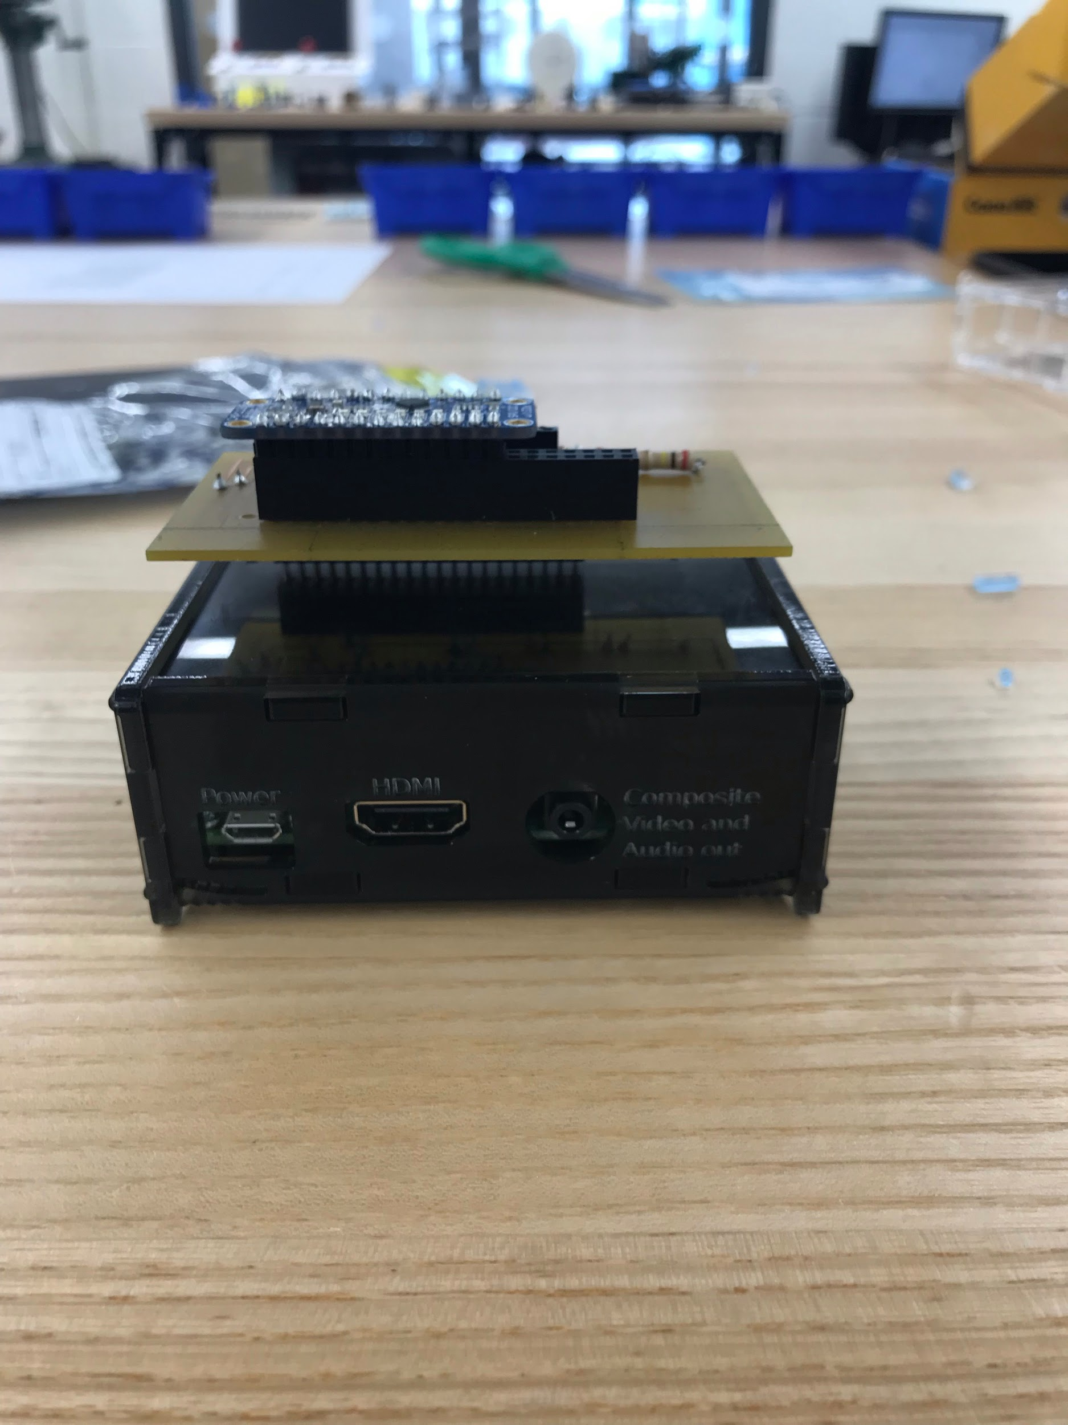
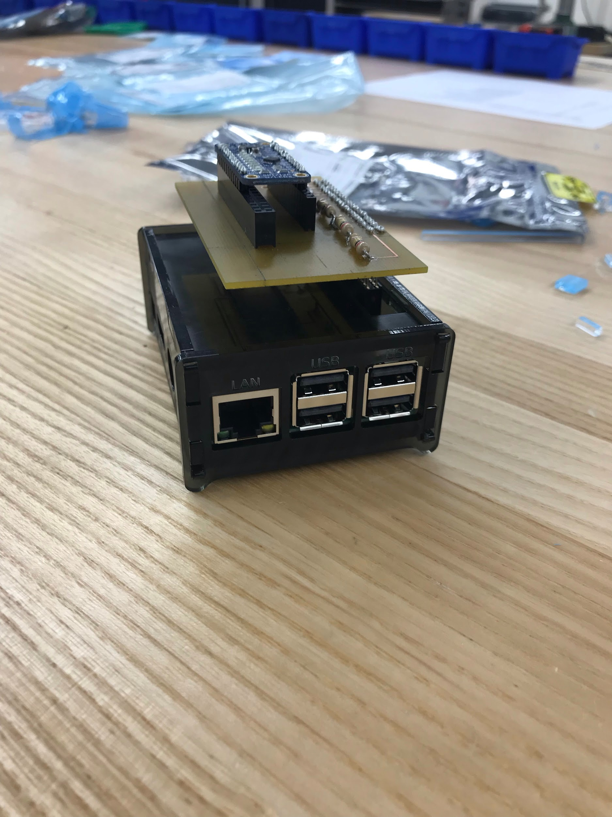
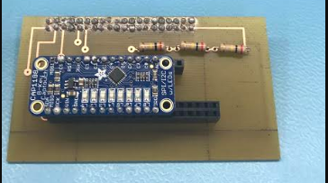
Final Product
Circuit Board for Sensor Case for Pi and Sensor

Slide 7
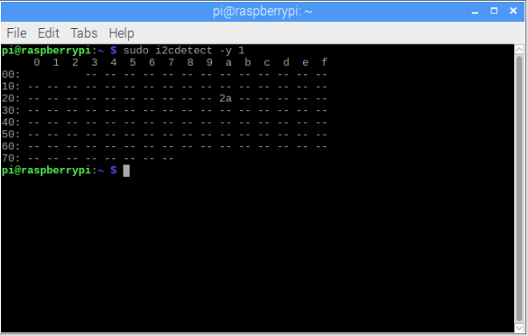
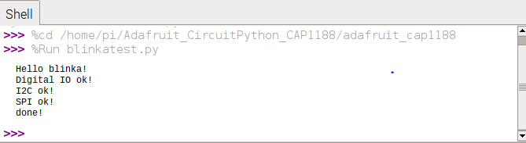
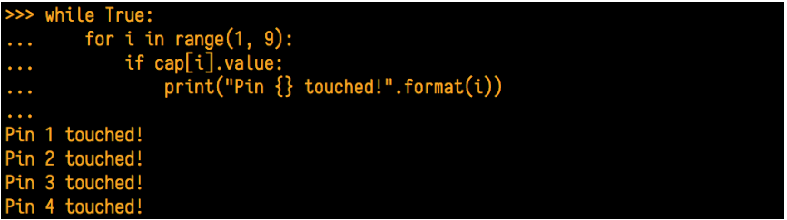
Outputs
Address (0x2A) Read/Writing to Sensor

Slide 8
Course Knowledge Applied
CENG 252 Embedded Systems
Working with Raspberry Pi
Ability to retrieve readings and write to sensors through applications
CENG 200 Unix Scripting
Traversing through unix systems (Use of commands)
Uploading and modifying files in Linx OS
CENG 216 Intro to Software Engineering
Use of Gantt Chart
TECH 153 Technical C
Programming in C

Slide 9
References
All code and build instructions acquired from Adafruit
https://learn.adafruit.com/adafruit-cap1188-breakout/python-circuitpython

